Slide 1
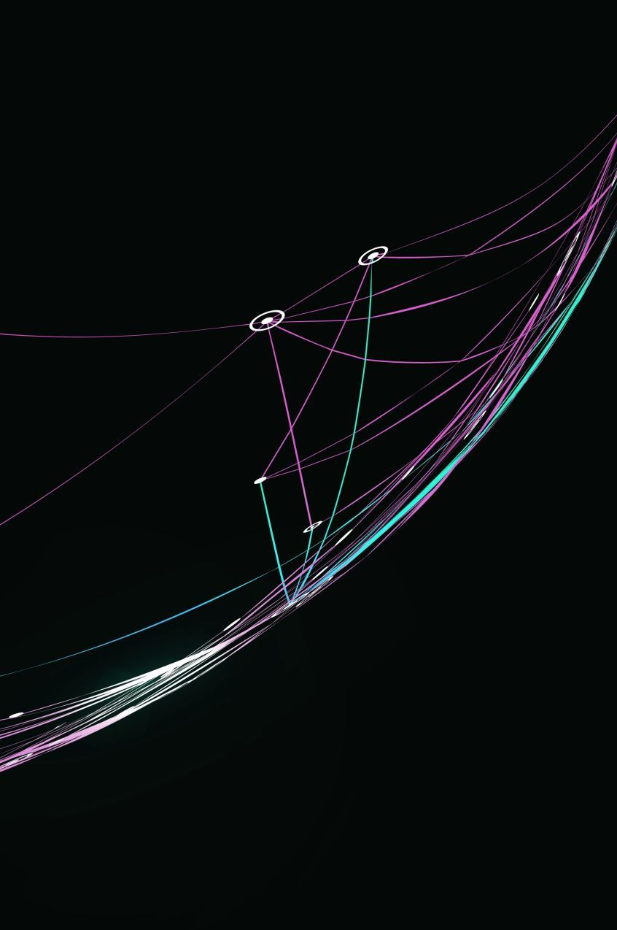
Research Project Proposal
Enhancing AI for Predictive Modeling of Shallow Well Locations in Ethiopia

Slide 2
Project summary
Project title: Enhancing AI for Predictive Modeling of Shallow Well Locations in Ethiopia
The goal of the project, "Enhancing AI for Predictive Modeling of Shallow Well Locations in Ethiopia," is to create an AI-powered application (called WellMapr) for end-users for locating sustainable well locations for small-scale farmers in Ethiopia.
The project uses GIS and machine learning to predict and increase water access for wider populations affected by climate change, erratic rainfall, draughts amidst a scarcity of availbale information

Slide 3
Project significance
Research problem: There is a lack of trustworthy groundwater data for rural Ethiopia. Most data is either dating back more than 10 years, or firmly in the hands of government agencies and authorities and thus not publicly available.
Project contribution to solution: Using AI-powered water resource mapping and prediction to combat food insecurity and strengthen water security and access.
The project is based on a cooperation between the UK-based NPO MapAid, the Czech Geological Survey (CGS) and the George Mason University in Virginia,USA.
Starting point and status quo is a prototype machine-learning based map of Bilate region, based on 75 well points

Slide 4
Research question
Main research question: How can machine learning (specifically an enhanced Gradient Boosting Regression model) be used to accurately predict shallow well locations in varied Ethiopian regions?
More specifically, our research poses the question "How can additional environmental and geographical features be incorporated into machine learning, specifically an improved Gradient Boosting Regression model, to accurately predict suitable shallow well locations across diverse regions in Ethiopia?"
Our attention is directed on model accuracy and real-world implementation by this query. It also involves the challenge of cross-discipline incorporation of domain knowledge (specifically geological and hydrological).

Slide 5
Aims and Objectives
General aim: Extend and improve WellMapr’s AI model for well location predictions by incorporating and testing new features in cooperation with domain experts.
Objectives:
Add data from Sidama, Gamo, and Gofa to the dataset.
Include new elements (seasonal patterns, soil makeup).
Work along with Ethiopian specialists and the Czech Geological Survey to incorporate domain knowledge

Slide 6
Key literature and existing research
Existing literature and research key findings:
With only a few models for groundwater prediction, artificial intelligence is uncommon in hydrogeology thus far (Pandey et al., 2020).
Current approaches depend on expensive technologies (such as ground-penetrating radar) or informed guesses.
The method used by WellMapr, which combines AI with open-source data, has demonstrated encouraging accuracy in pilot testing.
Identified gaps in existing literature and research:
Accessible AI-based techniques are required in high-need, low-resource regions, such as rural Ethiopia.
Predictive models based on geology and public climate data are used sparingly for shallow wells.

Slide 7
Key literature and existing research
Current studies and literature on AI in hydrogeology and identified gaps: -> High-resource sectors like petroleum exploration are the primary target of AI applications in hydrogeology (Morooka et al., 2001).
-> Smallholder farmers frequently lack access to expensive technologies like ground-penetrating radar or informed guesswork, which are the mainstays of traditional well-siting techniques in rural Ethiopia (Pandey et al., 2020).
-> The WellMapr project is the only one that uses machine learning to estimate groundwater depth using open-source data (such as geological and climate data), and initial trials have shown great accuracy with no cost.
-> Although AI models work well for monitoring the environment, few of them can meet the needs of low-resource agriculture, indicating a lack of easily available resources for managing water resources sustainably.
-> By offering a low-cost, AI-powered method of groundwater prediction, WellMapr aims to close this gap and assist scalable food security solutions.

Slide 8
Methodology Overview
Data collection: Add Sidama, Gamo, and Gofa to the data
Feature engineering: Include elements such as rainfall patterns, soil makeup, well yield and elevation
Use GBR for model training and testing, and consider benchmarking against alternative methods (e.g., Random Forest, Neural Networks)
Quantitative methods:
Data Collection: Quantitative information will be gathered from public sources, such as geology and climate data, as well as records of past well locations. These will include factors including soil composition, seasonal trends, rainfall, humidity, and land temperature.
Development of a Machine Learning Model: Because GBR works well with structured data, it will be used as the main model. Metrics like mean absolute error (MAE) and root mean square error (RMSE) will be used to assess the model's performance during training and validation.
Comparative Analysis: Other machine learning models, such as Random Forest and Neural Networks, may be used for comparative benchmarking in order to assess the robustness of GBR. This makes it easier to verify that GBR is the best model for achieving our prediction goals.
Data analysis: correlation and other statistical analyses to understand the relationship between environmental factors and groundwater depth, improving model accuracy.

Slide 9
Methodology Overview
Qualitative Methods:
Expert Consultation: Regular interviews and consultations will be conducted with hydrologists, geologists from the Czech Geological Survey, and local Ethiopian experts. This will ensure the model incorporates locally relevant features and aligns with practical knowledge.
User Feedback: Qualitative feedback from local stakeholders (e.g., farmers, NGOs) will be gathered to understand user requirements and adjust the model’s interface and outputs accordingly.
Field Testing: Qualitative assessments during field tests will evaluate the model’s usability and its impact on decision-making for well placements. Observations and interviews will help refine the tool based on real-world applications.

Slide 10
Model deployment
Application development: Create a user-friendly mobile application for convenient access.
The functionality will include: Interactive map, coordinate input, and water transport cost estimation.
Key users: Ethiopian small-scale farmers, NGOs, field workers and local government.
Our finished model will be made available open-source as a user-friendly mobile application for local users, including farmers and NGO employees. It will aid the users in allowing them to assess the suitability for a well in any given location.

Slide 11
Ethical considerations and risk
Main concerns:
Data privacy: In accordance with data protection rules, guarantee user privacy for those entering location and well data.
Transparency: To avoid relying too much on AI forecasts, explicitly explain the model's limitations to the end users
Equity and accessibility: Work with regional Ethiopian stakeholders to ensure that all communities have impartial, equitable access to the tool, preventing any inadvertent socioeconomic biases
Risk of misuse: Put in place controls and user instructions to stop improper tool use, which can result in well placements that are not sustainable.

Slide 12
Artefact descritpion
Main artefact (outcome):
AI-Powered software: An easily navigable, mobile-friendly software that provides well site forecasts for Ethiopian regions based on real-time inputs.
AI-Powered software: An easily navigable, mobile-friendly software that provides well site forecasts for Ethiopian regions based on real-time inputs.
Features:
Interactive map: To comprehend contributing aspects, users can explore suggested well placements and superimpose environmental data.
Feedback and input: Enables users to provide fresh well data, allowing the model to be improved over time using practical input (citizen science approach)
Cost Estimation: Assists in resource planning by offering rough cost estimates for water transport logistics.
Target audience: intended for use by Ethiopian government organizations, NGOs, and indigenous small-scale farmers

Slide 13
Timeline
Phase 1: Expansion of data. Gather fresh information (Sidama, Gamo, Gofa); include more characteristics (soil composition, seasonal patterns).
November through December of 2024
Phase 2: Creation of models. Add new features to the current GBR model and test the prototype.
January through February of 2025
Phase 3: First Experiments in newzones.Test the model in new Ethiopian zones and make adjustments in light of the preliminary findings.
March 2025
Phase 4: Improvement of the model. Improve feature weighting and prediction accuracy by refining the model in response to test feedback.
April 2025
Phase 5: Feedback from stakeholders and validation. Complete the last validation and get input from Ethiopian stakeholders and experts.
May 2025
Phase 6: Concluding documentation and analysis. Examine outcomes, compile conclusions, and finish the project report.
June 2025

